Slide 1
Whose Power is it Anyway? Local Government and the Renewable Energy Independent Power Producers Procurement Programme (REIPPP) in South Africa
6 June 2023 | Dr Thina Nzo

Slide 2
Whose Power is Anyway? Access to Energy is Power
“We owed Eskom R106 million. Eskom cut us [the municipality] from the electricity supply for two days during lock-down, when people lost their jobs and there was no revenue generated by our municipality. We were forced by Eskom to folk out R19 million in order to reconnect to the grid, coming from a hard lock-down. We even had electricity protests because people wanted to know why they are paying so much for electricity and still having electricity cuts while we have the IPPs on our back-door. This is a valid question...and in all fairness, with hight levels of poverty and electricity hikes…why can't we [the municipality] negotiate with these IPPs to sell us [the municipality] cheaper electricity directly?” (Mayor of Emthanjeni Municipality, 11 November 2020)

Slide 3
Introduction
The REIPPP programme has been marketed as a key pillar in South Africa’s Energy Just Transition to a low carbon economy, that allows private power producers to sell clean energy to the state utility Eskom
R250 billion (about US$16 billion) invested to-date on REIPP programme, 112 wind and solar projects across the country in Northern Cape, Western Cape and Eastern Cape, some parts of Free-State North-West Provinces contributing 6,300 MW into the grid.
Additional 12 Wind and 13 Solar project awarded in Bid Window 5 (2021) and 6 Solar projects in Bid Window 6 (2022)
Bolstered as a ‘green economy’ policy instrument which has been viewed as a way of ‘re-modelling’ or ‘re-engineering’ the economy through its potential of stimulating South Africa’s energy economy diversification, including the local economies of host municipalities.
On the other hand, the policy and planning dynamics between local municipalities and REIPPPP, and the community expectations of IPPs, have to date received little public scrutiny.
Since the inception of the REIPPP programme in 2010/11, very little is known about how REIPPP projects of this nature impacted on the infrastructure planning and socio-economic development of rural host municipalities, particularly underfunded and less developed municipalities which have limited resources and institutional capacity to leverage new forms of economic development. (i.e costs and financing of municipal bulk infrastructure vs renewable energy infrastructure)

Slide 4
Northern Cape Province as the ‘Green’ Economy Hub

Slide 5
Northern Cape Province as the ‘Green’ Economy Hub
By 2020, the Northern Cape Province hosts 59/112 REIPPP projects (89% of solar and wind), now planning for a Green Hydrogen Economy through Renewable Energy Development Zones. Germany being the lead investor in Green Hydrogen Import.
Yet we tend to engage in discourses of energy infrastructure, energy poverty and energy distribution from the centre, through the urban city governments, neglecting to examine the energy economic linkages between the periphery and the centre that at times reproduce socio-economic inequalities.
Northern Cape, as a province in the margins of the state is characterized by scattered settlements, low population densities, sinuous topographies and low economic activities and exploitable mineral and natural resources.
In Africa, margins reflect poverty, deprivation, under-resourced, under-development and sometimes failed service delivery yet they contribute to the country’s GDP through their extractive industries (mineral resources and energy)
This research report applies the terms ‘margins’ and ‘periphery’ interchangeably to describe municipalities in the Northern Cape’s geographical, socio-economic, governance positionality within the policy processes that contribute to the structural fixing of local municipalities and their local communities within the periphery of the South African state.

Slide 6
Objectives of the Research
This research examined:
the intergovernmental relations and planning processes that unfolded prior the construction project which ought to ensure the participation of local government;
steps taken by local government in spatial planning for REIPPP projects leading to implementation;
the implications of the IPP construction phase on municipal infrastructures, contributions towards municipal revenue and local economic development
and lastly the way in which communities relate to the afterlife of REIPPP in terms of the real socio-economic development value and benefits derived by communities.

Slide 7
Marginalisation of Rural Municipalities in Inter-governmental Relations
Renewable energy projects are ‘sold’ to local host communities on the grounds that they will revive a local economy, boost job creation, and raise local revenue for local host municipalities.
This is often unquestionably accepted by local host municipalities, particularly rural municipalities who have struggled to build their own economies and revenue base, with high unemployment and poverty.
Although these projects have been positioned as panaceas for local economic development, rural local municipalities have very influence in the way in which they are planned and implemented.
These projects are often highly centralised in their planning processes, national and provincial government often taking the lead starting from the inception of IRP agenda setting, formulation, adoption to the planning and procurement (Bid Windows and Site Identification), consolidation of capital investments and implementation stages (Construction).
South African Local Government Association (SALGA) and Department of Cooperative Governance and Traditional Affairs (COGTA) – bodies that represent and support local government in national planning processes in the Presidential Infrastructure Coordinating Committee (PICC) - have not been able to play this role effectively in representing the developmental priorities and fiscal concerns that ought to place rural local government interests at the centre of project development in the REIPP programme.

Slide 8
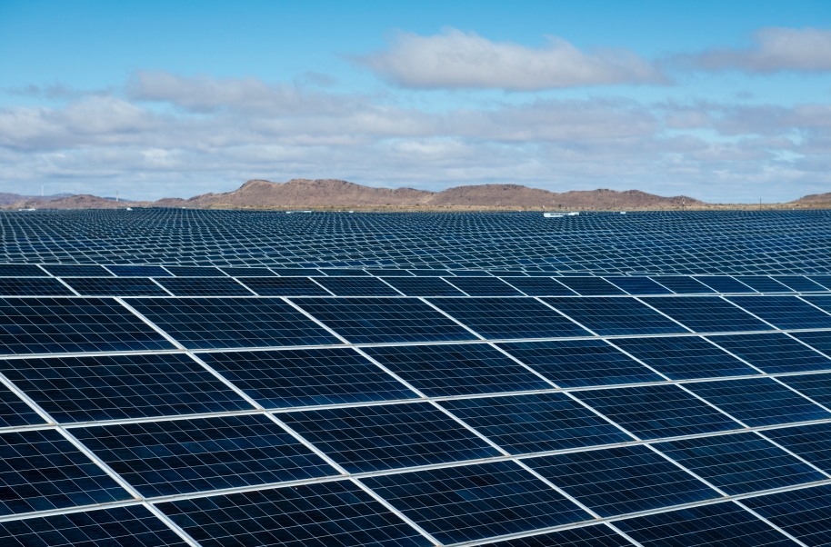
Emthanjeni Local Municipality

Slide 9
Impact of IPP Programme in Rural Municipalities in the Northern Cape: Experiences of Emthanjeni Municipality
Migration and Population Boom
Pressure on bulk infrastructure (water, sewerage, roads), dilapidation of road networks and eruption of informal settlements
Unregistered ‘fly-by-night’ landlords and speculatively property markets, increase residential rental prices.
Spatial Planning and Land Use Management (SPLUMA): Lack of Spatial Planning Capacity (Town Planning) and Infrastructure Development (Infrastructure Capital Budgets) and not integrated into the Municipal IDP
Inability to re-zone (from farms to commercial/industrial SE Zones)
Grant dependency and substantial loss of (revenue) levies, higher tariffs, taxes and rates from IPPs.
Municipal litigation against IPPs who refuse to pay local rates yet lease land from white farm owners at R1million per/month
Unskilled local labour: conflict between migrant workers and local labour and cases of sexual exploitation of local young women
Dependency on international highly skilled specialists, contractors and consultants and project managers
Capital outflows: SMME supplier development programme not benefitting local communities
Social and Economic Development Plans (SED) and Community Trusts not reaping substantial benefits
Employment decline after construction, automated industry leading to unemployment and inability to collect revenue from households (electricity revenue losses), unaffordable electricity and questioning the presence of IPPs. By 2017/18, the municipality recorded a budget deficit and loss of R88 million, which can be attributed to a 16% increase in expenditure, while revenue grew by only 1%
eMthanjeni Municipality’s debt owed to Eskom currently sits at R56 million

Slide 10
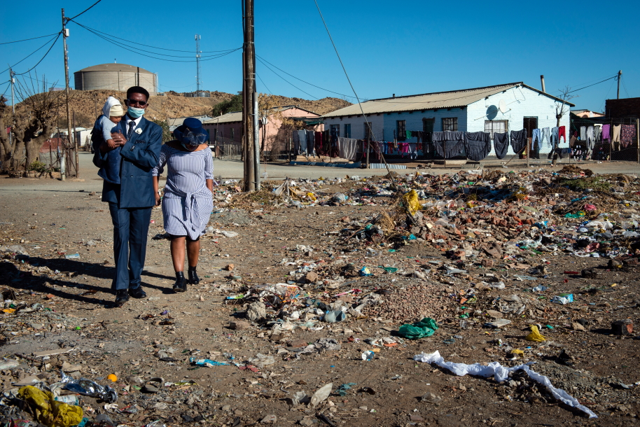
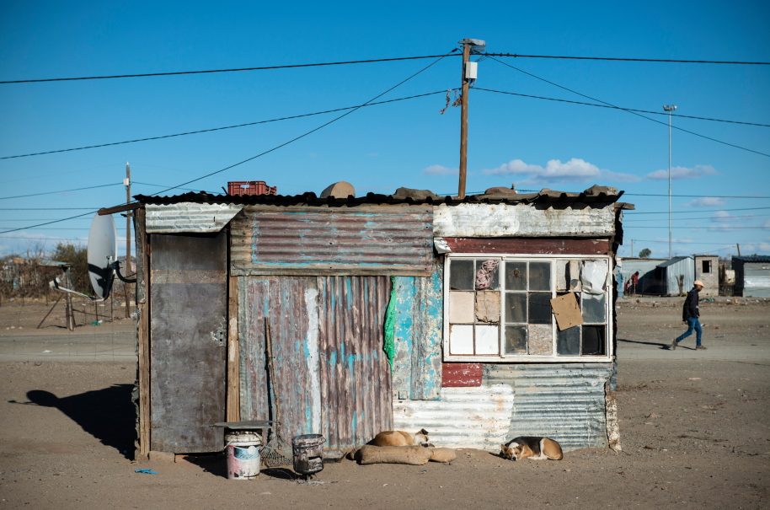
Nonzwakazi Township, eMthanjeni Municipality

Slide 11
Sasol Interface programmes/projects to consider 3/3
Imagination of the State in the eyes of the State

Slide 12
Conclusion about the state and IPPs
The research presented in this report argues that the centralised policymaking approach and economic path-dependency in spatial development of renewable energy infrastructure in the REIPPP programme contributes to the reproduction of structural disempowerment and displacement of rural municipalities into the margins of policymaking.
These projects are often associated with major extractive and industrial schemes and landlocked regions which are a primary target. Ultimately, the desire to open them up is based on a desire to accrue increased resource extraction for the state (often to political elites) and private sector.
The REIPPP programme demonstrates segments of path-dependency political-economy that either largely preserve or replicate existing dynamics of power that strengthen the powerful at the centre while weakening the marginalised on the periphery of the state.
The irrelevance of placing rural local government on the margins in the process of policy decision-making and planning also means that the state tends to neglect resource distribution to peripheral municipalities. It is these resources that should be re-invested into the infrastructural development of under-resourced municipalities that contribute to the economy of the state by hosting renewables projects.
How can rural municipalities better position their socio-economic, fiscal and infrastructure interests in the upcoming Green Hydrogen Development in the Northern Cape?

Slide 13
Thank you!

