Slide 1
Benedikt Walker
Renewable power: territorial conflicts &
Uneven development
in germany
@bene_walker

Slide 2
Outline
Background: The German energy transition
Case study: Reasons for unresolved territorial conflicts in Germany
1. Territoriality of planning wind turbines
2. Territoriality of power generation & demand; electricity prices
3. Territoriality of wind energy value chain
4. Alternative development models (than renewable energy)
Consequences & solutions

Slide 3
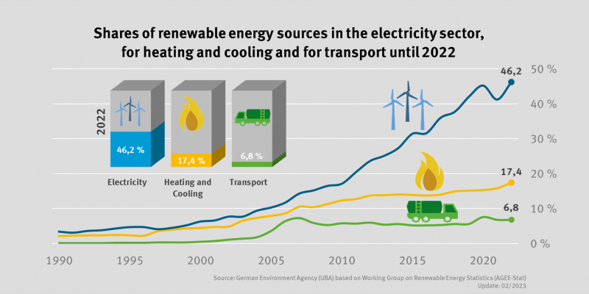
The German Energy transition
2030: Renewable energy sources should produce 80% of electricty
2045: Climate neutrality
https://www.umweltbundesamt.de/en/topics/climate-energy/renewable-energies/renewable-energies-in-figures

Slide 4
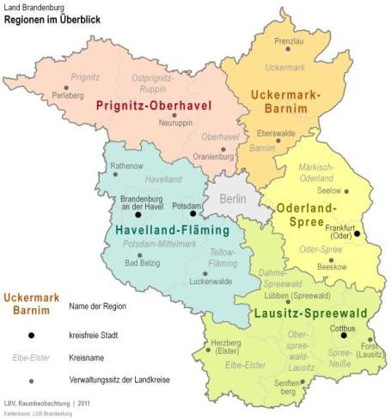
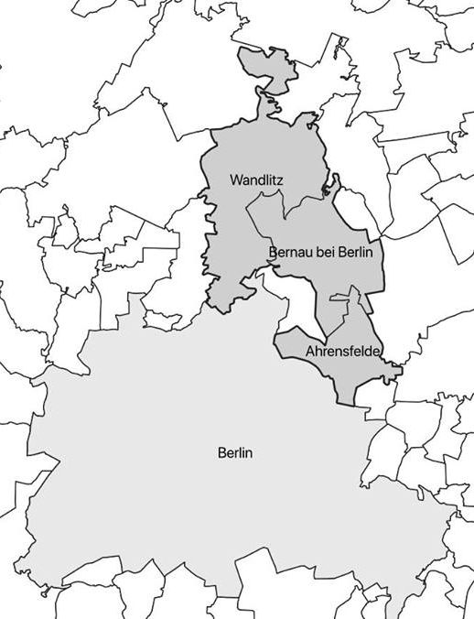
Case Study context & multilevel Governance
https://de.wikipedia.org/wiki/Datei:Map_Germany_L%C3%A4nder-de.svg
https://gl.berlin-brandenburg.de/regionalplanung/regionalplaene/regionen

Slide 5
Case study: The declaration of bernau (2018)
Demands: (1) No wind turbines closer than 1500 meters to houses, (2) no wind turbines in forrests, (3) financial/economic participation of municipalities, (4) protection of landscape
https://bernau-live.de/nachrichten/barnim/270-buergermeister-und-ortsvorsteher-gegen-massiven-windkraftausbau
https://www.moz.de/lokales/bernau/windenergie-wie-bernau-und-ahrensfelde-und-eine-bi-aus-wandlitz-auf-das-windkraft-urteil-des-ovg-reagieren-55441594.html

Slide 6
Reasons for territorial conflicts I: Territoriality of renewable energy planning
Municipalities have no veto power
Higher political levels (e.g. national government, federated states, regions) define exclusion criteria:
Nature reserves
Distances to houses (800 meters)
Forrests (?)
Airports
….
https://gl.berlin-brandenburg.de/regionalplanung/regionalplaene/regionen

Slide 7
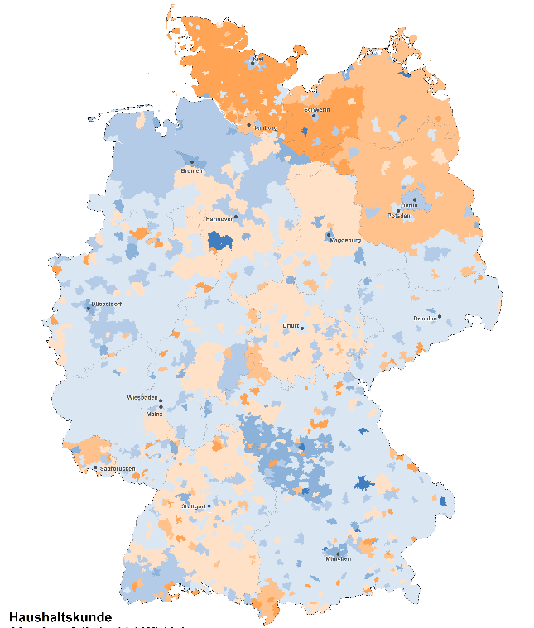
Reasons for territorial conflicts II: Territoriality of (renewable) energy system
Territoriality of Generation and Demand
Territoriality of consumer prices
Installed renewable energy capacity per 1 Mio. Inhabitants (2022),
red high, yellow low
Consumer grid levies (2022)
orange high, blue low
https://twitter.com/bbsr_bund/status/1661261976301887488/photo/1
https://www.bundesnetzagentur.de/SharedDocs/A_Z_Glossar/N/Netzentgelt.html?gtp=1095790_list%253D2

Slide 8
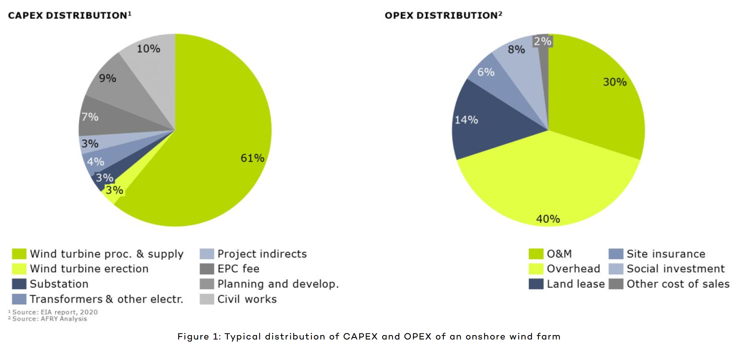
Reasons for territorial conflicts III: Territoriality of Wind energy Value Chain
70% of total costs
30% of total costs
Planning
Financing
Manufacturing
Construction
Maintenance & Operation
Deconstruction
Recycling / Landfill
Berlin
Berlin
(Inter-)National
Local/Regional
Berlin
Local/Regional
National/Local
https://afry.com/en/insight/wind-change-guide-improve-your-wind-farms-profitability
Notes:
Overhead costs are those that are not directly related to the production of goods or services, but are necessary for the operation of a business. Examples of overhead costs include rent, utilities, insurance, legal fees, office supplies, advertising, payroll, and accounting fees

Slide 9
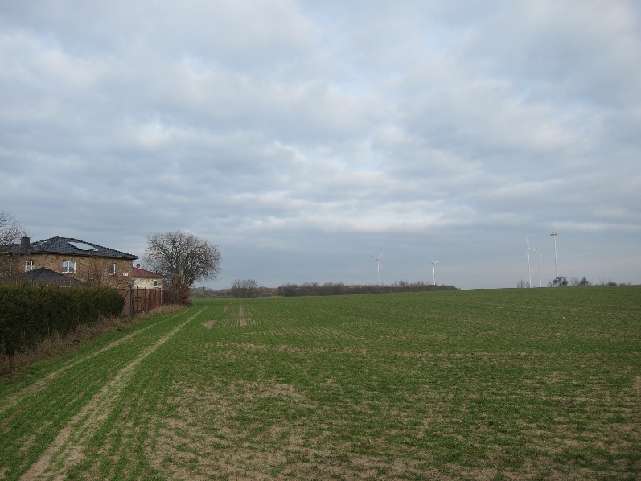
Reasons for Territorial Conflicts IV: Alternative development models
Housing development for commuters
„beautiful agricultural landscape“ vs. „industrial wind towers“

Slide 10
Outcomes & Solutions of territorial conflicts & uneven development
outcomes
solutions
German renewable energy developers search for business opportunities abroad (e.g. South Africa: Enertrag)
German national government searching for hydrogen imports (e.g. South Africa)
„Fair“ distribution of renewable energy sources accross municipalities (urban and rural)
Renewable energy developers should pay taxes to host municipalities (10.000€ per wind turbine/year)
Local population should pay lower electricity/grid prices

Slide 11
Thank you for your
Attention!
benediktwalker@uni-bonn.de

Slide 12
https://www.cleanenergywire.org/news/german-onshore-wind-growth-achieves-turnaround-2020-still-target

Slide 13
https://www.cleanenergywire.org/factsheets/solar-power-germany-output-business-perspectives
Notes:
https://www.cleanenergywire.org/factsheets/solar-power-germany-output-business-perspectives

Slide 14
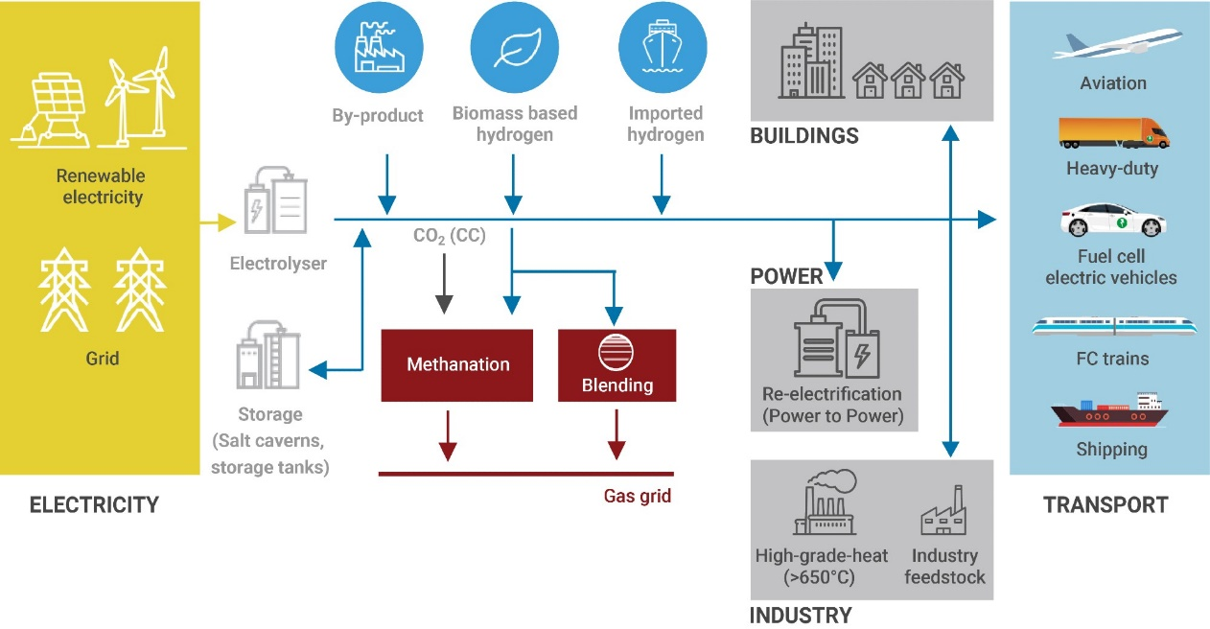
The German MOIS for Hydrogen Technologies: sectoral und technological characteristics
2019 IRENA
Notes:
IRENA. (2019). Hydrogen from Renewable Power. Last Access: 18.5.2022. https://www.irena.org/energytransition/Power-Sector-Transformation/Hydrogen-from-Renewable-Power

Slide 15
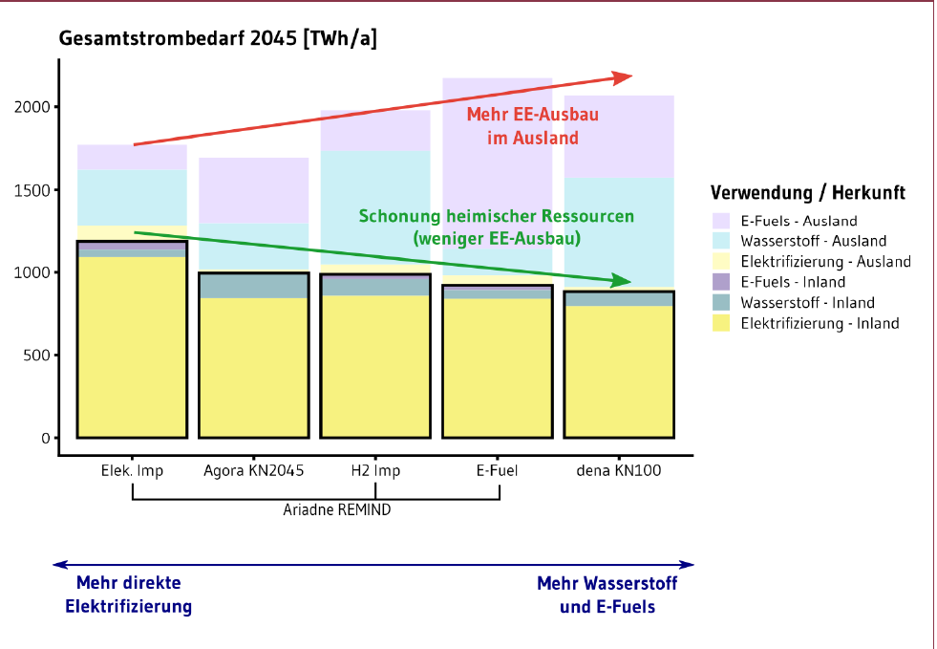
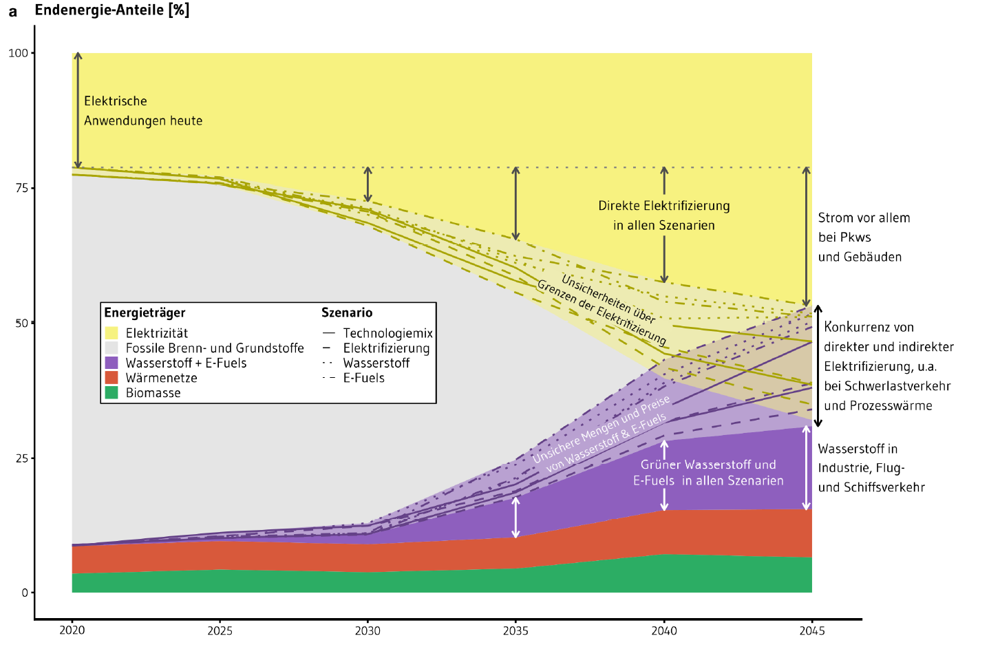
Ueckerdt et al. 2021:12

